Slide 1
HTTP 1.0
15 May 18 | Start
Appendix
Online

Slide 2
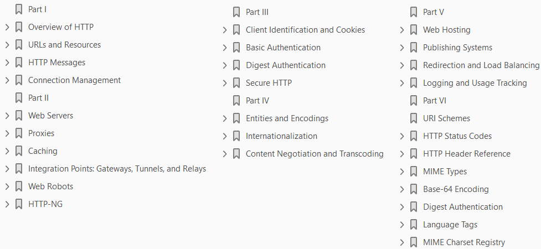
HTTP 1.0
Ch | Date
1 | 00 May 18
2
3
4
5
6
7
8
HTTP 1.0 The Definitive Guide 10 2002

Slide 3
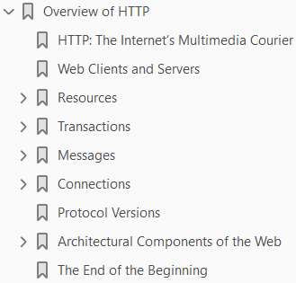
1
Overview of HTTP

Slide 4
Intro
The world’s web browsers, servers, and related web applications all talk to each other through HTTP, the Hypertext Transfer Protocol.
HTTP is the common language of the modern global Internet.
This chapter is a concise overview of HTTP.
You’ll see how web applications use HTTP to communicate, and you’ll get a rough idea of how HTTP does its job.
In particular, we talk about:
How web clients and servers communicate
Where resources (web content) come from
How web transactions work
The format of the messages used for HTTP communication
The underlying TCP network transport
The different variations of the HTTP protocol
Some of the many HTTP architectural components installed around the Internet
We’ve got a lot of ground to cover, so let’s get started on our tour of HTTP.

Slide 5
HTTP: The Internet’s Multimedia Courier
Billions of
JPEG images
HTML pages
text files
MPEG movies
WAV audio files
Java applets, and more
cruise through the Internet each and every day
HTTP moves the bulk of this information quickly, conveniently, and reliably from web servers all around the world to web browsers on people’s desktops.
Because HTTP uses reliable data-transmission protocols, it guarantees that your data will not be damaged or scrambled in transit, even when it comes from the other side of the globe.
This is good for you as a user, because you can access information without worrying about its integrity.

Slide 6
HTTP: The Internet’s Multimedia Courier |
Reliable transmission is also good for you as an Internet application developer, because you don’t have to worry about HTTP communications being destroyed, duplicated, or distorted in transit.
You can focus on programming the distinguishing details of your application, without worrying about the flaws and foibles of the Internet.
Let’s look more closely at how HTTP transports the Web’s traffic.

Slide 7
Web Clients and Servers
Web content lives on web servers.
Web servers speak the HTTP protocol, so they are often called HTTP servers.
These HTTP servers store the Internet’s data and provide the data when it is requested by HTTP clients.
The clients send HTTP requests to servers, and servers return the requested data in HTTP responses, as sketched in Figure 1-1.
Together, HTTP clients and HTTP servers make up the basic components of the World Wide Web.
You probably use HTTP clients every day.
The most common client is a web browser, such as Microsoft Internet Explorer or Netscape Navigator.
Web browsers request HTTP objects from servers and display the objects on your screen.
When you browse to a page, such as “http://www.oreilly.com/index.html,” your browser sends an HTTP request to the server www.oreilly.com (see Figure 1-1).
The server tries to find the desired object (in this case, “/index.html”) and, if successful, sends the object to the client in an HTTP response, along with the type of the object, the length of the object, and other information.

Slide 8
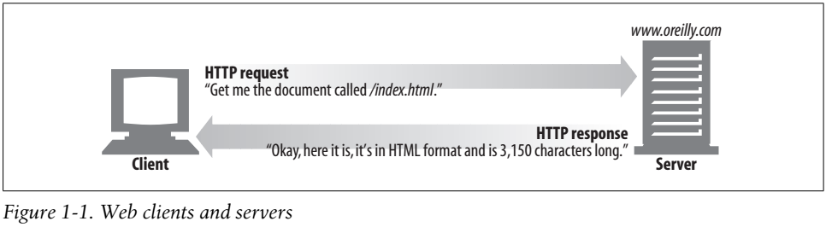
Figure 1-1

Slide 9
Resources
Web servers host web resources.
A web resource is the source of web content. The simplest kind of web resource is a static file on the web server’s filesystem. These files can contain anything: they might be text files, HTML files, Microsoft Word files, Adobe Acrobat files, JPEG image files, AVI movie files, or any other format you can think of. However, resources don’t have to be static files. Resources can also be software programs that generate content on demand. These dynamic content resources can generate content based on your identity, on what information you’ve requested, or on

Slide 10
Transactions
Let’s look in more detail how clients use HTTP to transact with web servers and their resources.
An HTTP transaction consists of
a request command (sent from client to server)
a response result (sent from the server back to the client)
This communication happens with formatted blocks of data called HTTP messages, as illustrated in Figure 1-5.

Slide 11
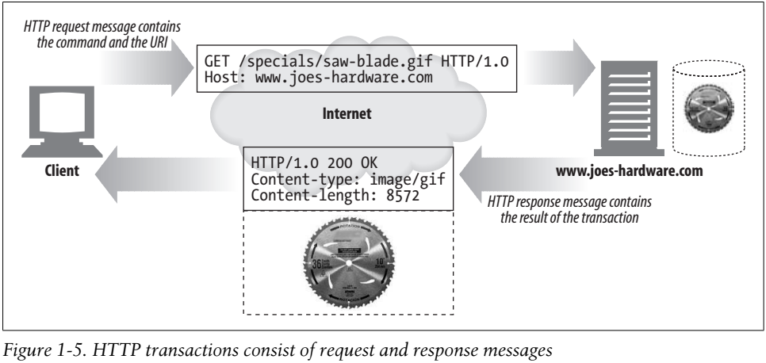
Figure 1-5

Slide 12
Methods
HTTP supports several different request commands, called HTTP methods.
Every HTTP request message has a method.
The method tells the server what action to perform (fetch a web page, run a gateway program, delete a file, etc.).
Table 1-2 lists five common HTTP methods.

Slide 13
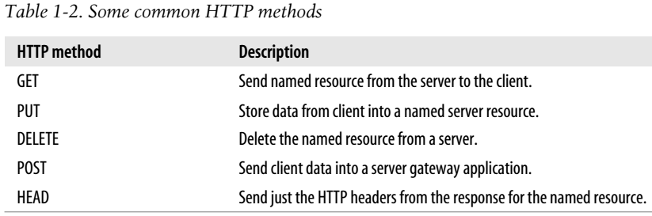
Table 1-2

Slide 14
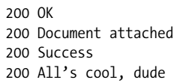
Status Codes
Every HTTP response message comes back with a status code.
The status code is a three-digit numeric code that tells the client if the request succeeded, or if other actions are required.
A few common status codes are shown in Table 1-3.
HTTP also sends an explanatory textual “reason phrase” with each numeric status code (see the response message in Figure 1-5).
The textual phrase is included only for descriptive purposes
the numeric code is used for all processing.
The following status codes and reason phrases are treated identically by HTTP software:
HTTP status codes are explained in detail in Chapter 3.

Slide 15
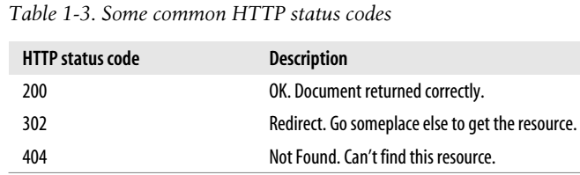
Table 1-3

Slide 16
Web Pages Can Consist of Multiple Objects
An application often issues multiple HTTP transactions to accomplish a task.
For example, a web browser issues a cascade of HTTP transactions to fetch and display a graphics-rich web page.
The browser performs
one transaction to fetch the HTML “skeleton” that describes the page layout,
then issues additional HTTP transactions for each
embedded image
graphics pane
Java applet, etc.
These embedded resources might even reside on different servers, as shown in Figure 1-6.
Thus, a “web page” often is a collection of resources, not a single resource.

Slide 17
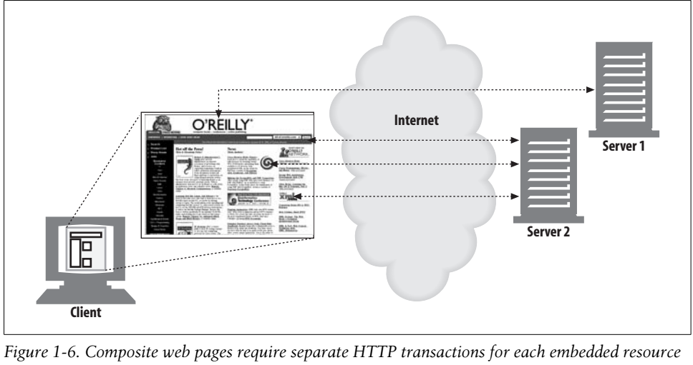
Figure 1-6

Slide 18
Messages
Now let’s take a quick look at the structure of HTTP request and response messages. We’ll study HTTP messages in exquisite detail in Chapter 3. HTTP messages are simple, line-oriented sequences of characters. Because they are plain text, not binary, they are easy for humans to read and write.* Figure 1-7 shows the HTTP messages for a simple transaction.
(Page 10).

Slide 19
Connections
Now that we’ve sketched what HTTP’s messages look like, let’s talk for a moment about how messages move from place to place, across Transmission Control Protocol (TCP) connections.
(Page 11).

Slide 20
Protocol Versions
There are several versions of the HTTP protocol in use today. HTTP applications need to work hard to robustly handle different variations of the HTTP protocol. The versions in use are:
(Page 16).

Slide 21
Architectural Components of the Web
In this overview chapter, we’ve focused on how two web applications (web browsers and web servers) send messages back and forth to implement basic transactions. There are many other web applications that you interact with on the Internet. In this section, we’ll outline several other important applications, including: Proxies HTTP intermediaries that sit between clients and servers Caches HTTP storehouses that keep copies of popular web pages close to clients Gateways Special web servers that connect to other applications Tunnels Special proxies that blindly forward HTTP communications Agents Semi-intelligent web clients that make automated HTTP requests
(Page 17).

Slide 22
The End of the Beginning
That’s it for our quick introduction to HTTP. In this chapter, we highlighted HTTP’s role as a multimedia transport protocol. We outlined how HTTP uses URIs to name multimedia resources on remote servers, we sketched how HTTP request and response messages are used to manipulate multimedia resources on remote servers, and we finished by surveying a few of the web applications that use HTTP. The remaining chapters explain the technical machinery of the HTTP protocol, applications, and resources in much more detail.
(Page 21).

Slide 23
2

Slide 24
Intro

Slide 25
3

Slide 26
Intro

Slide 27
4

Slide 28
Intro

Slide 29
5

Slide 30
Intro

Slide 31
6

Slide 32
Intro

Slide 33
7

Slide 34
Intro

Slide 35
8

Slide 36
Intro

Slide 37
9

Slide 38
Intro

Slide 39
10

Slide 40
Intro

